Slide 1
ICT Spreadsheets Lesson 2: Working with Charts

Slide 2
Objectives – Lesson 2
8.2.3: Identify various types of charts (e.g., line, bar, pie, scatter) and common chart components (e.g., vertical axis, horizontal axis, legend), and explain when to use each chart type.
8.2.4: Create various types of charts based on data sets defined in a spreadsheet.
8.2.5: Modify chart types to appropriately represent base data.

Slide 3
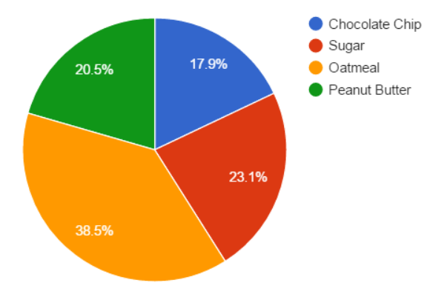
Utilizing Spreadsheet Charts
A chart creates a visual image of a range of data.
Helps others understand the large amounts of data collected
Types of Charts:
Line Chart
Area Chart
Column chart or Bar Chart
Scatter Chart
Pie chart

Slide 4
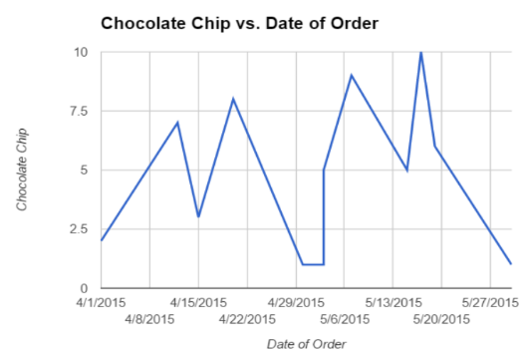
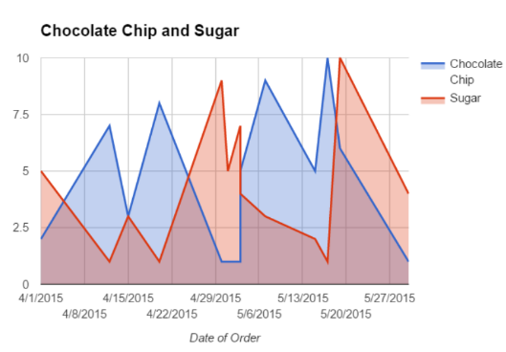
Types of Charts
Line Chart – used to show a trend in data over periods of time.
Area Chart – used to represent cumulated totals over time, comparing two or more quantities – similar to a line chart.

Slide 5
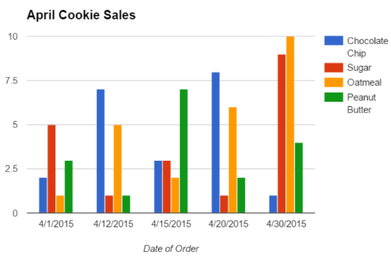
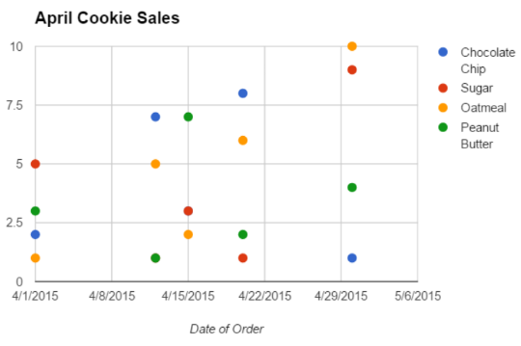
Types of Charts
Column or Bar Chart – used to show comparisons among categories.
Vertical bars are Column charts. Horizontal bars are Bar charts.
Scatter Chart – used to identify the type of relationship (if any) between categories and/or variables.

Slide 6
Types of Charts
Pie chart - used to compare a single category of values as parts of a whole.
**The pie chart is the only exception to data series because every point in the series is assigned a color.
Data series is a series of points that are plotted on a chart or graph.
Each data series is assigned a color or pattern to uniquely identify it.
Name | Date of Order | Chocolate Chip | Sugar | Oatmeal | Peanut Butter
Mary | 4/1/2015 | 2 | 5 | 1 | 3
Rose | 4/12/2015 | 7 | 1 | 5 | 1
Sue | 4/15/2015 | 3 | 3 | 2 | 7
Louis | 4/20/2015 | 8 | 1 | 6 | 2
Robert | 4/30/2015 | 1 | 9 | 10 | 4
Steve | 5/1/2015 | 1 | 5 | 1 | 7
Mary | 5/3/2015 | 1 | 7 | 10 | 6
Rose | 5/3/2015 | 5 | 4 | 2 | 2
Sue | 5/7/2015 | 9 | 3 | 1 | 1
Louis | 5/15/2015 | 5 | 2 | 5 | 1
Robert | 5/17/2015 | 10 | 1 | 3 | 9
Steve | 5/19/2015 | 6 | 10 | 6 | 2
Mark | 5/30/2015 | 1 | 4 | 5 | 1
Totals | 6/1/2015 | 59 | 55 | 57 | 46

Slide 7
Chart Elements
Horizontal axis contains the data series headings or time frames
Vertical axis is populated by your spreadsheet program based upon all the values in your data series.
Legend maps the color to the data series
Chart title identifies the information being displayed in the chart.
Chart Title
Legend
Vertical Axis
Horizontal Axis

Slide 8
Insert, Design, and Format Charts
Once you Insert the type of chart you’d like to create the Design tab provides quick access to the following design elements:
Add Chart Element – such as title, legend, gridlines
Quick Layout – Use a default chart layout
Change Colors – Change the color scheme
Chart Styles – Apply a preset design to your chart
Switch Row/Column Data
Select Data – Change the range of cells containing your chart data.
Change Chart Type – lets you select another type of chart for your data.
Move Chart Location

Slide 9
Insert, Design, and Format Charts
The additional formatting tools in the Format tab are:
Insert Shapes:– Insert a shape into your chart.
Shape Styles – Change the style of the shape you insert.
WordArt Styles – Apply and format to components of your chart.
Arrange – Arrange the objects added to the chart.
Size – Alter the width and height of the chart.

Slide 10
Insert, Design, and Format Charts
Three icons appear along the top-right corner of the chart:
Chart Elements: Add, remove or change chart elements such as title, legend, gridlines and chart labels. This is the same command as the Add Chart Elements button on the Design tab.
Chart Styles: Apply a preset design to your chart, including colors and layouts. This is the same command as the Chart Styles section of the Design tab.
Chart Filters: Gives you access to filters for the chart data. This includes selected specific Values and Names for each of Series and Categories.

Slide 11
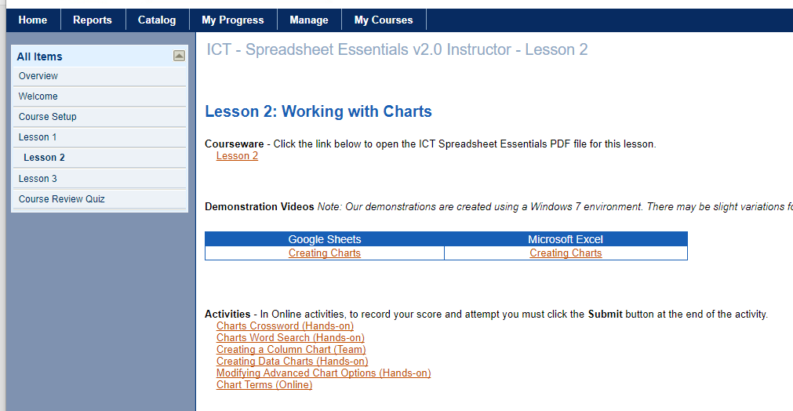
Let’s Watch the Video
How to Create Charts in Google Sheets and Excel
Click Here
Notes:
Discuss types of connections – “Connecting to the Internet” video

